Slide 1
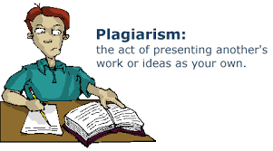

Slide 2
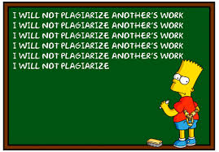
WHAT IS PLAGIARISM?
Many people think of plagiarism as copying another's work or borrowing someone else's original ideas. But terms like "copying" and "borrowing" can disguise the seriousness of the offense

Slide 3
DICTIONARY
to steal and pass off (the ideas or words of another) as one's own
to use (another's production) without crediting the source
to commit literary theft
to present as new and original an idea or product derived from an existing source

Slide 4
MORE INFORMATION
http://www.plagiarism.org
https://www.refme.com
scan the barcode
http://owll.massey.ac.nz
https://www.citethisforme.com/
Notes:
Referencing Sources:
OPEN REFME
Plagiarism.org – for information on plagiarism
Owll.massey – how to reference
Citethisforme – next side

Slide 5
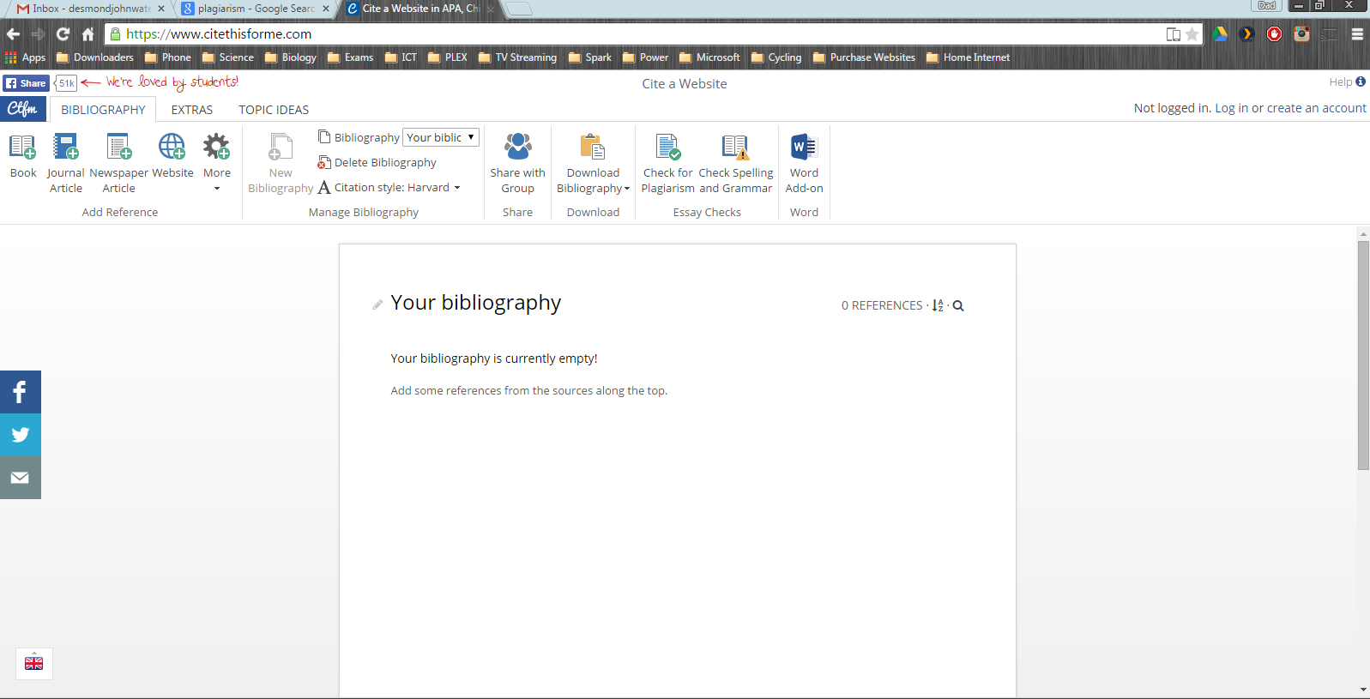
- It will make a reference list for you, but you still need to reference in the written text – e.g. Wikipedia
Notes:
This will make a reference list for you

Slide 6
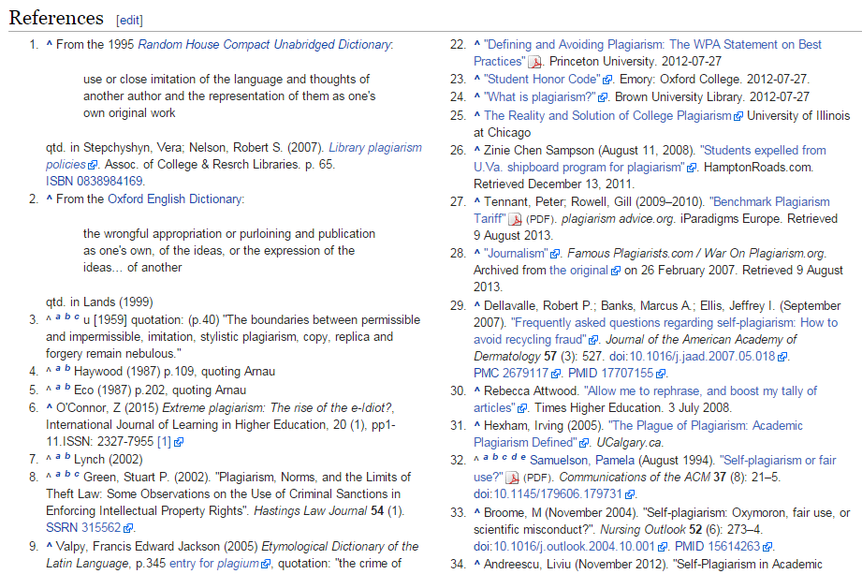
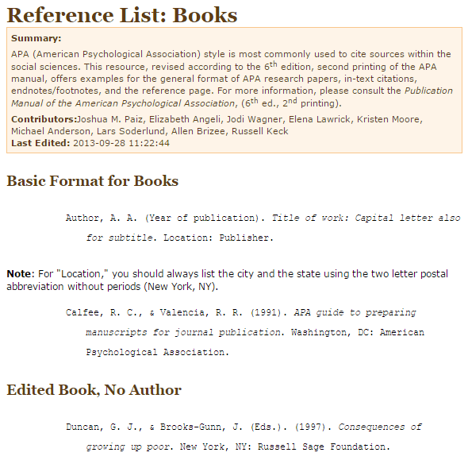
How to reference
Notes:
This is how to reference. You can do it for science but may be different depending on the subject.

Slide 7
Turnitin (Stratus) Google classroom – revision history
Notes:
You will have to submitted your work to turnitin from next year and you WILL get caught cheating

Slide 8
Notes:
Click on the assignment button

Slide 9
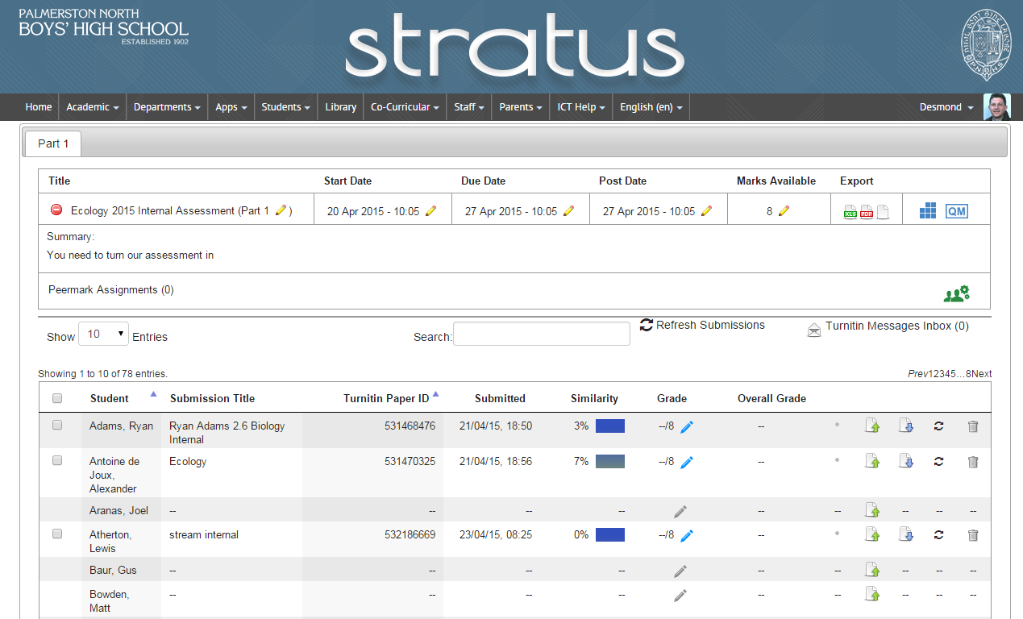
Notes:
Use 7% as an example

Slide 10
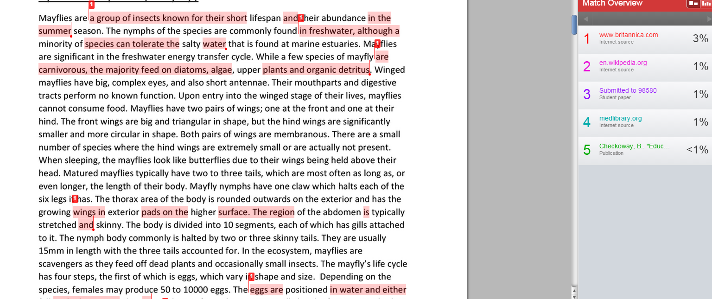
Note the side bar
Notes:
7% copied – it would have been better to reference this

Slide 11
See what you have taken from other peers work and even the original source
Notes:
I can see what he copied from his friend assignment

Slide 12
NOT okay!!!!! Turnitin looks at the whole internet, not just your class or school
Notes:
29% copied and no references – NOT OKAY
10% from his mate

Slide 13
Summary of Plagiarism

