Slide 1
Debating: Big Ideas
Why it is important to group your points into Big Ideas
(and what your Big Ideas should be)

Slide 2
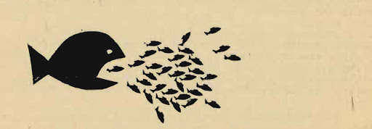
A Single Big Idea is better than several small ideas
Adjudicators will always favour a well-developed Big Idea, over several Small Ideas.
Big Ideas look at a the big picture
A Big Idea is likely to have a greater impact on people than small ideas
A Big Idea shows a synthesis of smaller ideas

Slide 3
Big Idea (Mainstream)
Correct Solution → Is the solution proposed the correct solution to the correct problem?
Net Benefit to Society → Do the Pros outweigh the Cons. Usually this is built into another idea
Feasibility (Implementation) → How will it be implemented, and will it actually work?
Unintended Consequences → What are some hypothetical ramifications, positive or negative?
Moral High Ground → What is the most right thing to do? Is it the most ethical option?
Environmental Impact → Both on Ecology and Carbon Footprint
Economic Impact → Big picture (National), and small picture (Family / Individual)
Human Impact → How will this affect people’s mental, social, spiritual and physical well-being?

Slide 4
Big Ideas (Niche)
Ends Justifies the means (success is all that matters) → Tough problems require tough solutions
(Dis)advantaging minorities (or any population sub-set) → How this will affect certain minorities?
Human Rights → Does this infringe on our Human Rights? (Right to Privacy, due process, security of person, etc.)
Fairness → Equality (All the same), Equity (the amount to be successful), merit (deserves), Fairness (What is ‘fair’)
The Role of Government → What is it we expect the government to do / take care of?
Reasonable expectations (Social Contract) → Example: What is reasonable for an Employer to expect of workers?
Security → Does it make us more safe? Does it protect us? Does it keep us from harm/danger?
Combating / Reinforcing isms → Sexism, Racism, Ageism, colonialism, feminism, etc.
Culture / Identity → How does this apply to existing culture, respecting culture, and creating culture?
The (universal) human nature → Why do humans do what they do?

Slide 5
Group your small ideas into Big Ideas!

