Slide 1
WHY TAKE GEOGRAPHY?

Slide 2
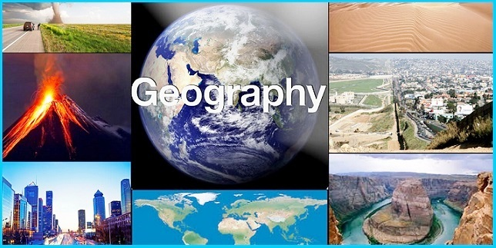
https://www.youtube.com/watch?v=mUv5kkKVBLw&feature=related

Slide 3
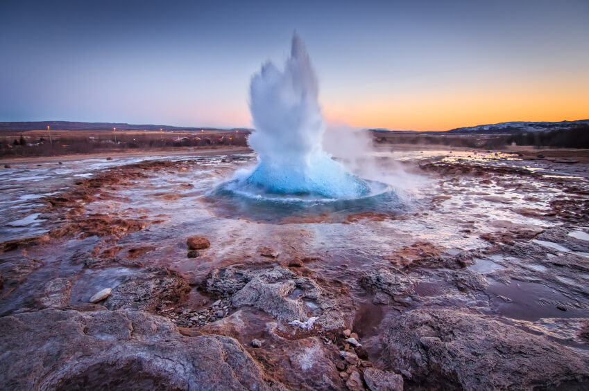
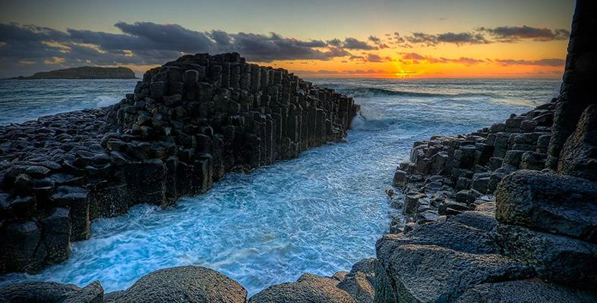
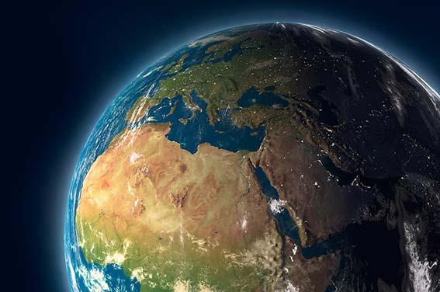

Slide 4
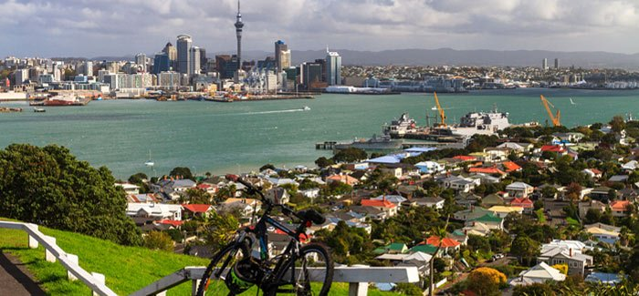
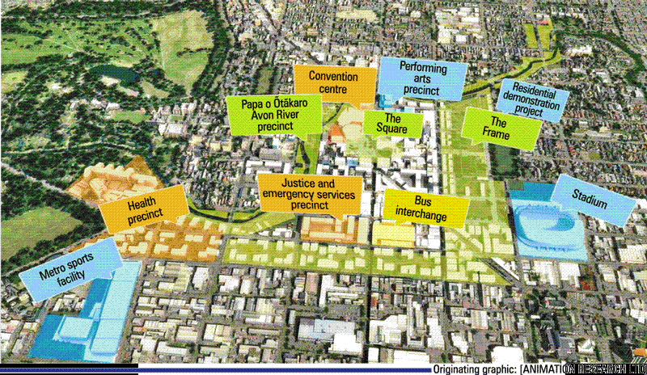
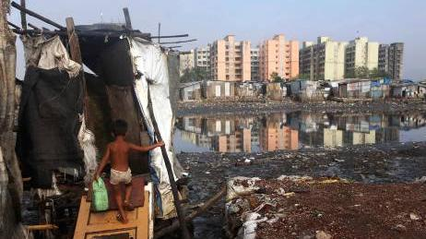
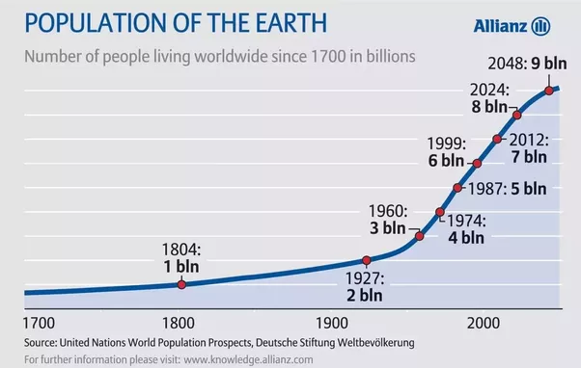
CHRISTCHURCH EARTHQUAKE REBUILD

Slide 5
SUSTAINABILITY
https://www.youtube.com/watch?gl=US&feature=related&hl=uk&v=JyhSHDGg-cw

Slide 6
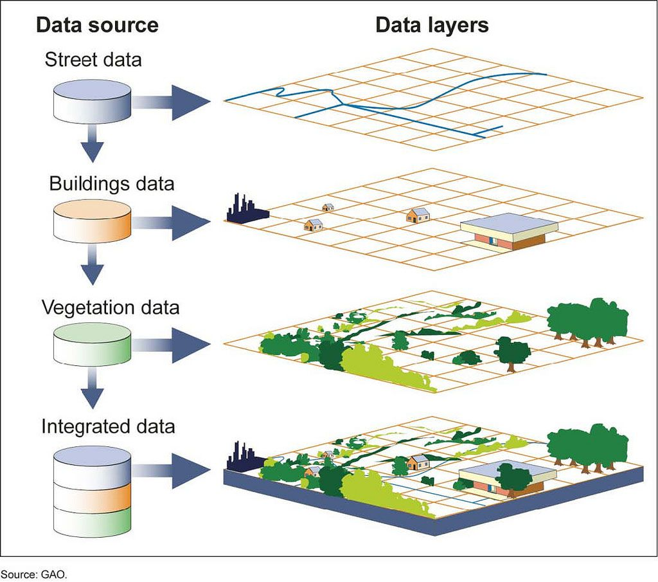
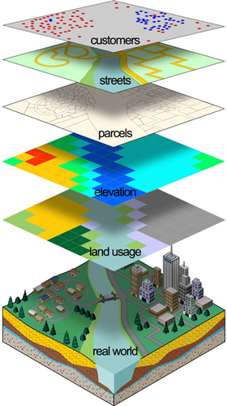
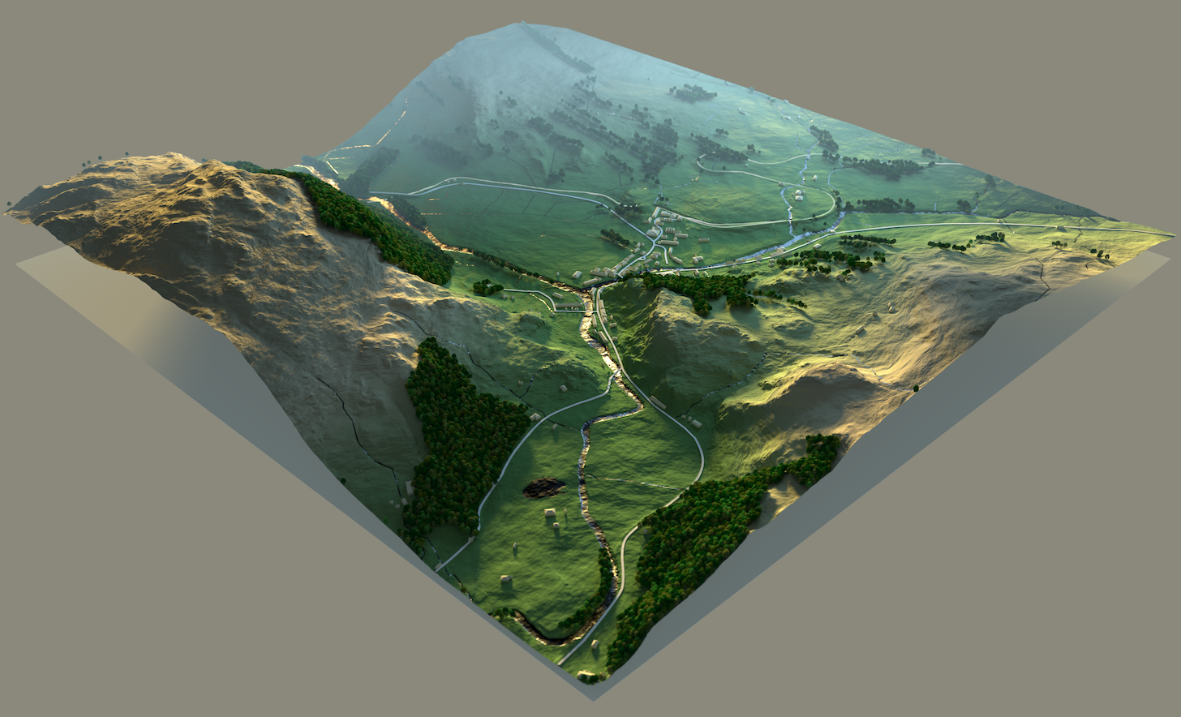
GEOGRAPHIC INFORMATION SYSTEMS (GIS)

Slide 7
Geographers earned a median salary of $80,300 per year in 2018, according to the BLS. They may concentrate on researching Earth and it's geographic features (known as physical geography) or focus on researching cultural groups and issues related to mankind's relationship with Earth (known as human geography).Jan 30, 2020

Slide 8
http://www.youtube.com/watch?gl=US&hl=uk&v=dDk06h7Abbw

Slide 9
https://www.youtube.com/watch?v=6Mj8MTWZX4M

Slide 11
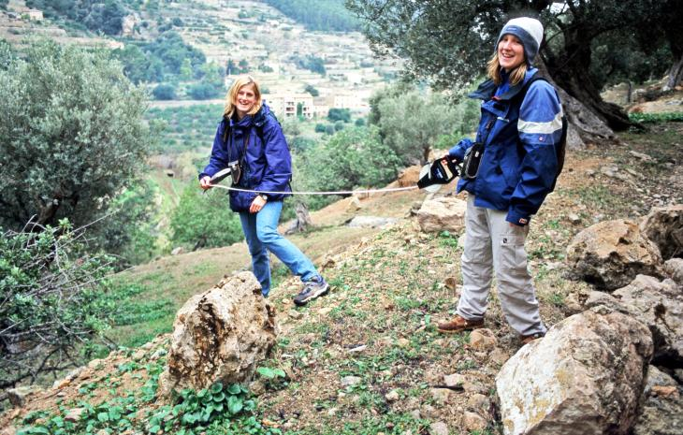
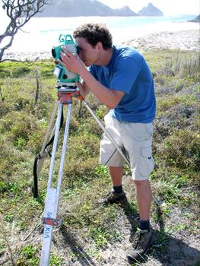
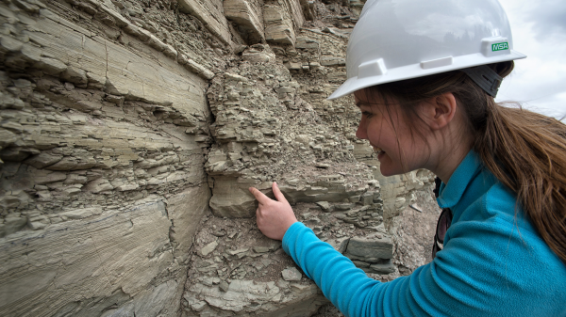
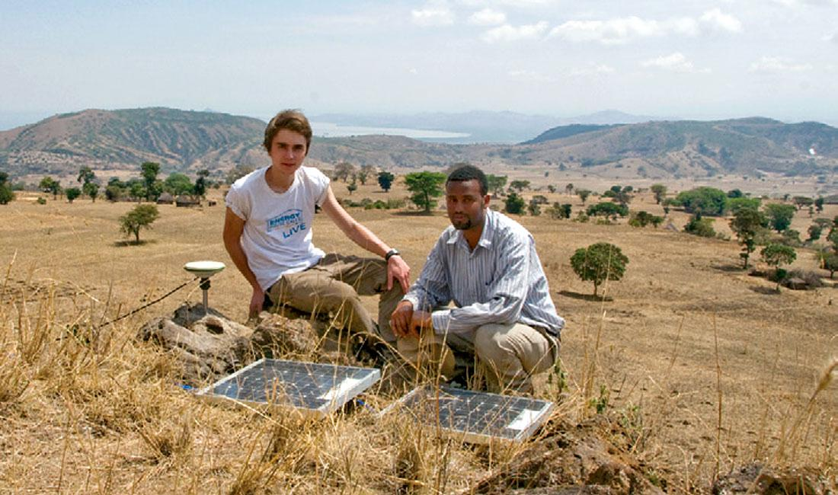
GEOGRAPHERS AT WORK

Slide 12
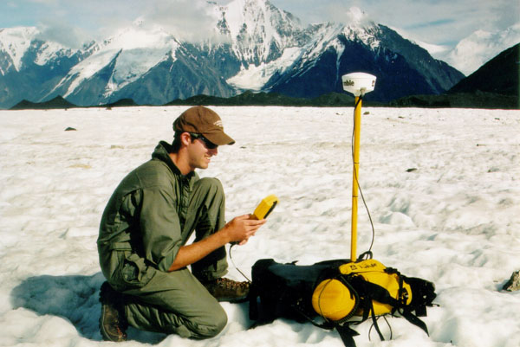
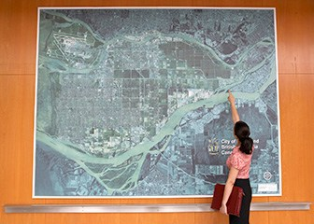
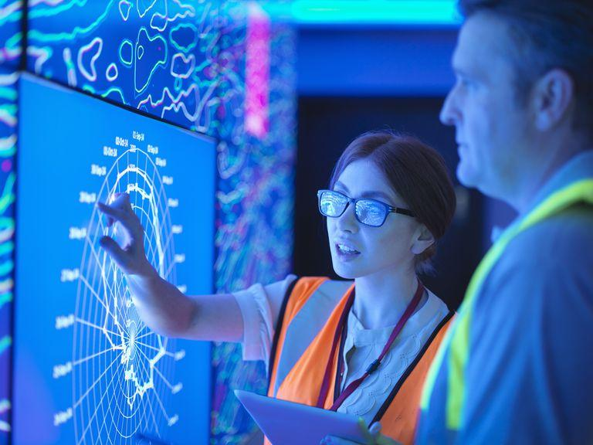
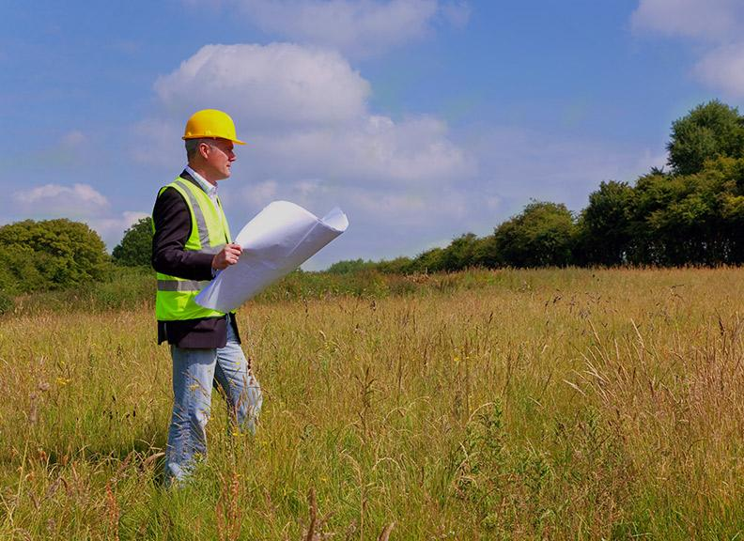
GEOGRAPHERS AT WORK

Slide 13
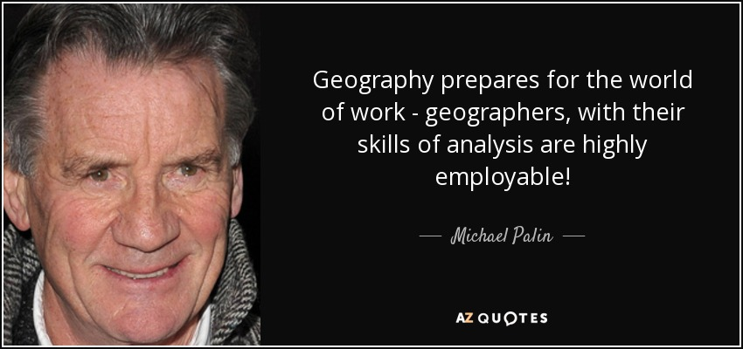

Slide 17
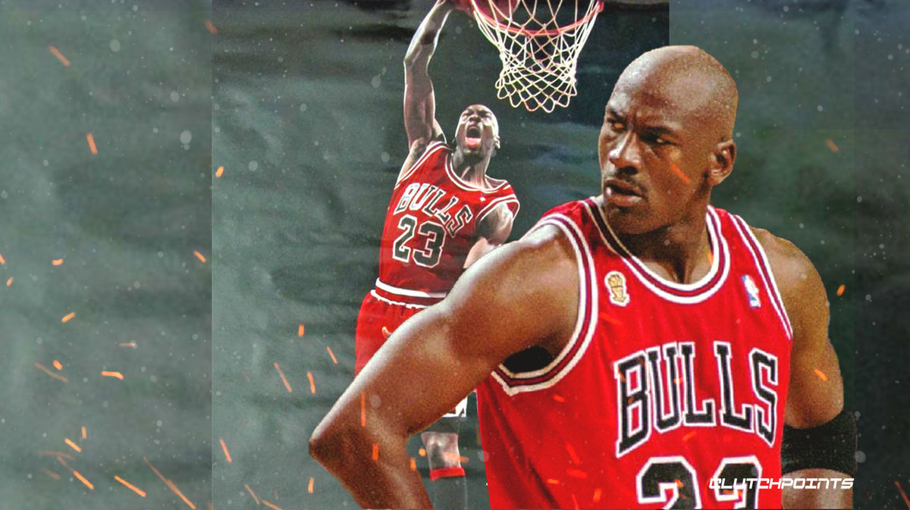
FAMOUS PEOPLE WHO STUDIED GEOGRAPHY
After winning the Naismith and the Wooden College Player of the Year awards in 1984, Jordan left North Carolina one year before his scheduled graduation to enter the 1984 NBA draft. ... Jordan returned to North Carolina to complete his degree in 1986. He graduated the same year with a Bachelor of Arts degree in geography.
Michael Jordan

Slide 18
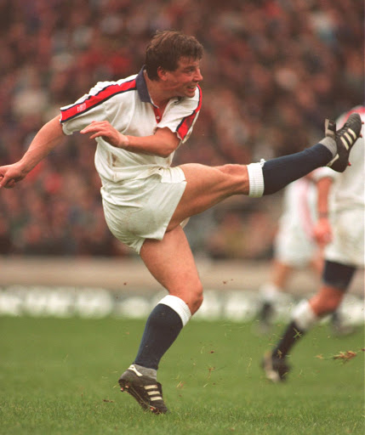
FAMOUS PEOPLE WHO STUDIED GEOGRAPHY
Rob Andrew (born 1963) is a former England Rugby Union Player and Professional Rugby Director of the Rugby Football Union who studied geography at Cambridge.

Slide 19
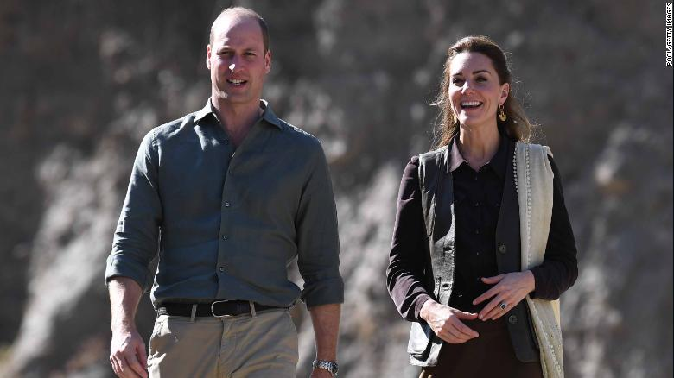
FAMOUS PEOPLE WHO STUDIED GEOGRAPHY
The Duke of Cambridge studied at the University of St Andrews, where he initially pursued a degree in art history before changing his main subject to geography in the second year. Prince William graduated with a master of arts, earning a 2:1.
Prince William

Slide 20
FAMOUS PEOPLE WHO STUDIED GEOGRAPHY
Sir Michael Niko Jones is a New Zealand former rugby union player and coach. He was named by Rugby World magazine as the third best All Black of the 20th century after Colin Meads and Sean Fitzpatrick. John Hart, who first selected him for Auckland, called him "almost the perfect rugby player". Jones graduated from Auckland with three degrees, a Bachelor of Arts, Master of Arts and Bachelor of Planning.
Michael Jones

Slide 21
SO WHAT’S STOPPING YOU?
PICK GEOGRAPHY AND GO PLACES!!!
https://www.youtube.com/watch?v=t_a5OLScri0

